Slide 1

Detection of phishing websites using machine learning approach
PROJECT-IIi (PAPER CODE : PROJ – CS881 )
BACHELOR OF TECHNOLOGY
IN
COMPUTER SCIENCE AND ENGINEERING
BY
GROUP G NAME | ROLL No. | REGISTRATION No.
SOUHARDYA GAYEN | 14400118005 | 181440110033
SHREYA KAYAL | 14400118008 | 181440110030
NITISH RANJAN NASKAR | 14400118024 | 181440110014
UNDER THE GUIDANCE OF
Dr. BAPPADITYA MONDAL
(Assistant Professor,Department of CSE, NITMAS)
AT
NEOTIA INSTITUTE OF TECHNOLOGY , MANAGEMENT AND SCIENCE
(AFFILIATED TO MAULANA ABUL KALAM AZAD UNIVERSITY OF TECHNOLOGY, WEST BENGAL,
INDIA AND APPROVED BY AICTE, NEW DELHI, INDIA)
JUNE , 2022
BATCH : 2018 - 2022

Slide 2

CONTENTS
Sl No | TOPIC | SLIDE No
1. | OBJECTIVE | 3
2 | ABSTRACT | 4
3. | SHORT INTRODUCTION | 5
4. | PROPOSED METHOD / WORK | 6
5. | STEP1 :- DATA COLLECTION | 7-8
6. | STEP 2 :- EDA | 9-10
7. | STEP 3 :- DATA CLEANING | 11-12
8. | STEP 4 :- FEATURE SELECTION TECHNIQUES | 13-14
9. | STEP 5 :- MACHINE LEARNING ALGORITHMS | 15-18
10. | RESULT | 19
11. | CONCLUSION | 20-21
12. | FUTURE SCOPE | 22
13. | REFERENCE | 23

Slide 3

OBJECTIVE
A phishing website is a common social engineering method that mimics trustful uniform resource locators (URLs) and webpages. The objective of this project is to train machine learning models and deep neural nets on the dataset created to predict phishing websites. Both phishing and benign URLs of websites are gathered to form a dataset and from them required URL and website content-based features are extracted. The performance level of each model is measured and compared. We have used 30 features to train the data set to detect whether it is phishing or legitimate website.

Slide 4
ABSTRACT
In recent years, advancements in Internet and cloud technologies have led to a significant increase in electronic trading in which consumers make online purchases and transactions. This growth leads to unauthorized access to users’ sensitive information and damages the resources of an enterprise. Phishing is one of the familiar attacks that trick users to access malicious content and gain their information. In terms of website interface and uniform resource locator (URL), most phishing webpages look identical to the actual webpages. However, due to inefficient security technologies, there is an exponential increase in the number of victims. The anonymous and uncontrollable framework of the Internet is more vulnerable to phishing attacks. Existing research works show that the performance of the phishing detection system is limited. There is a demand for an intelligent technique to protect users from the cyber-attacks. Hence, we proposed a URL detection technique based on machine learning approaches. We evaluated the proposed method with 5000 malicious and 5000 legitimate sites, respectively. The experiments’ outcome shows which proposed method’s performance is better in malicious URL detection.

Slide 5
SHORT INTRODUCTION
Phishing is a social engineering attack that aims at exploiting the weakness found in the system at the user’s end. For example, a system may be technically secure enough for password theft but the unaware user may leak his/her password when the attacker sends a false update password request through forged (phished) website. For addressing this issue, a layer of protection must be added on the user side to address this problem. A phishing attack is when a criminal sends an email or the url pretending to be someone or something he’s not, in order to get sensitive information out of the victim. The victim in regard to his/her curiosity or a sense of urgency, they enter the details, like a username, password, or credit card number, they are likely to acquiesce. The recent example of a Gmail phishing scam that targeted around1 billion Gmail users worldwide.
As phishing attack allows attackers a foothold in corporate networks causing access to vital information, it is important to safeguard users from becoming victims of fraud. Thus phishing detection tools play a vital role in ensuring security. So we planned to work on this topic.

Slide 6
PROPOSED METHOD / WORK
We have taken a dataset consisting of 30 features. We have then further proceeded with Exploratory Data Analysis , Data Cleaning and also applied Feature Selection Algorithm and different types of Machine Learning algorithm like Decision Tree , Support Vector Machines and Random Forest.

Slide 7

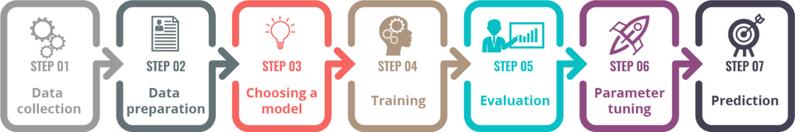

DATA COLLECTION
the process of gathering and measuring information from countless different sources
to answer stated research questions, test hypotheses, and evaluate outcomes
collected dataset from the internet –https://www.kaggle.com/code/akashkr/phishing-url-eda-and-modelling/data

Slide 8
THE dataset consists of 30 features which are as following :-
1.ADDRESS BAR BASED FEATURES :-
1. IP Address
2. URL Length
3. Shortening service
4. @ symbol
5. redirecting using //
6. Prefix-Suffix
7. Sub Domain
8. SSL final state
9. Domain registration length
10. Favicon
11. Non-Standard Port
12. HTTPS Token
2.HTML AND JavaScript BASED FEATURES :-
Pop-up Window
IFrame redirection
Disabling Right Click
Website Forwarding
Status Bar Customization
3.DOMAIN BASED FEATURES :-
1. Age of Domain
2. DNS Record
3. Website Traffic
4. Page Rank
5. Google Index
6. links pointing to page
7. Statistical-Report
4.ABNORMAL BASED FEATURES :-
Request URL
URL of Anchor
Links in tags
Server Form Handler
Submitting information to email
Abnormal URL

Slide 9
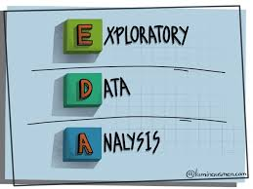
STEP 2:-
EDA :-
to discover patterns
to spot anomalies
to test hypothesis
to check assumptions
with the help of summary
statistics and graphical
representations.

Slide 10
The Steps We Have Followed In EDA Are As Following :-
Variable Identification :-
1. identify Predictor and Target variables.
2. identify the data type of the variables.
Univariate Analysis :-
1. continuous Variable Analysis
2. categorical Variable Analysis
Bivariate Analysis :-
1. two variables for any combination of categorical
and continuous variables
2. target with any other predictor

Slide 11

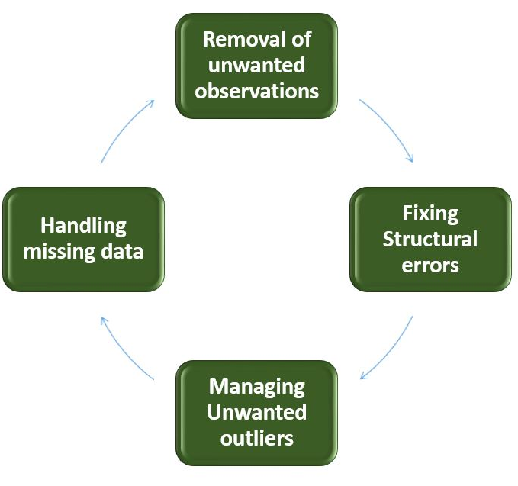
DATA CLEANING:-
Incorrect
Incomplete
Irrelevant
Duplicated
Improperly formatted.

Slide 12
The Steps We Have Followed In DATA CLEANING Are As Following :-
1.Handling Duplicate Data :-
2. Handling missing value :-
checks for the duplicates rows
returns True and False
1. checking if there is null value

Slide 13

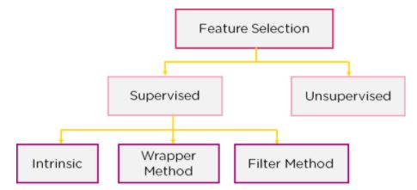
FEATURE SELECTION TECHNIQUES :-
to reduce the input variable
to use only relevant data
to get rid of noise in data

Slide 14
The TECHNIQUES We Have UTILISED In FEATURE SELECTION Are As Following :-
1.VARIANCE THRESHOLD
to remove Constant and Quasi Constant Features
assuming that features with a higher variance may contain more useful information.
2.REMOVE THE DUPLICATE FEATURES
1. remove the Duplicate Categorical Features
3. ANOVA(Analysis of Variance) or F-Test
1. testing the individual effect of each of features with
target.
2. A univariate test

Slide 15
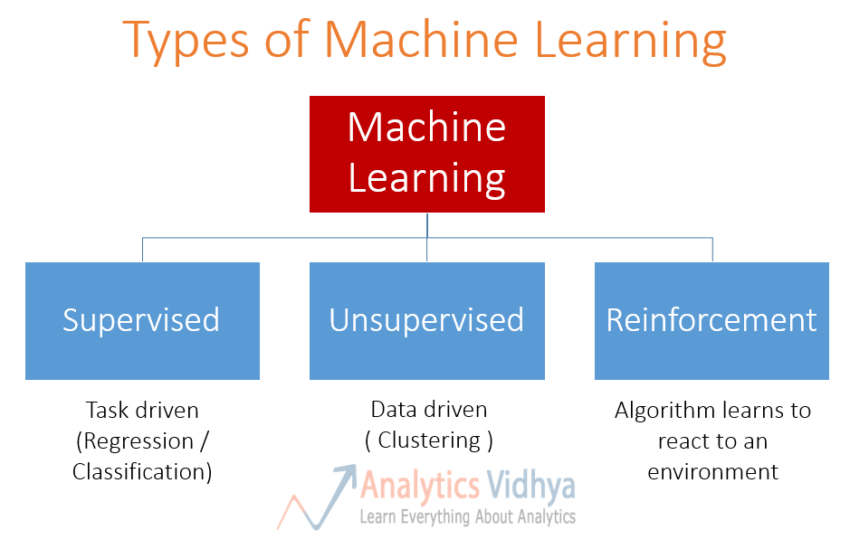
MACHINE LEARNING ALGORITHM :-
STEP 5:-
the method by which the AI system conducts its task
predicting output values from given input data
two main processes - classification and regression.

Slide 16
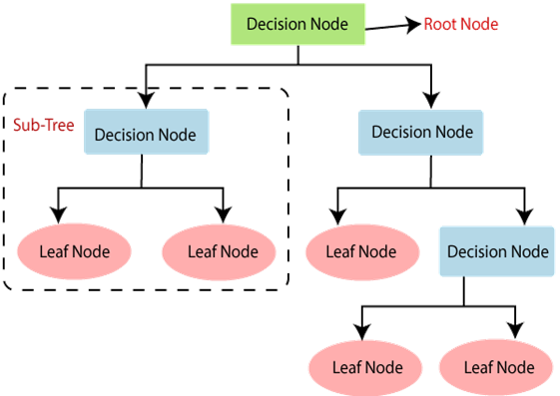
The MACHINE LEARNING ALGORITHMS We Have IMPLEMENTED In OUR PROJECT Are As Following :-
1. DECISSION TREE ALGORITHM:-
tree-structured classifier
internal nodes represent the features of a dataset
branches represent the decision rules
each leaf node represents the outcome

Slide 17
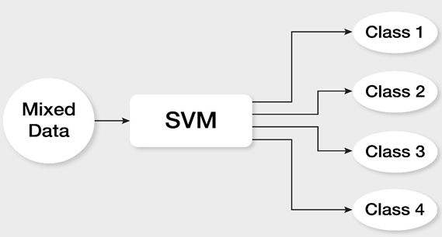
2. SUPPORT VECTOR MACHINE (SVM) ALGORITHM: -
1. used for both classification and regression (mostly in classification
problems) 2. plotting each data item as a point in n-dimensional space where n is
number of features
3. the value of each feature being the value of a particular coordinate

Slide 18
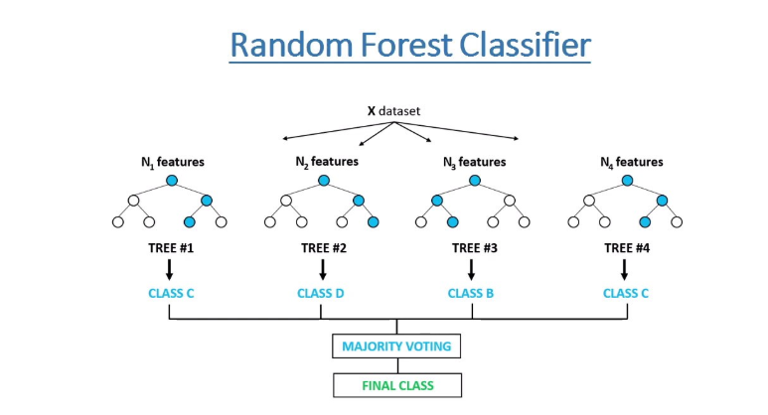
3. RANDOM FOREST ALGORITHM:-
1. supervised learning technique.
2. used for both Classification and Regression problems
in ML
3. ensemble learning

Slide 19
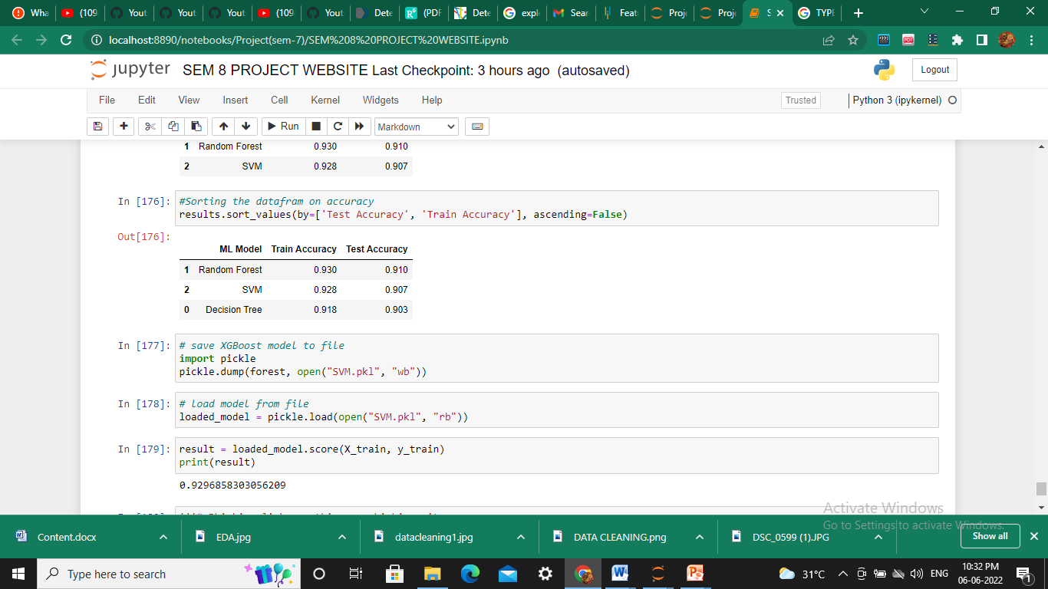
RESULT
After applying the three Machine Learning Algorithms, we have trained and tested the model . We have performed model evaluation to determine which model gives the better performance.

Slide 20
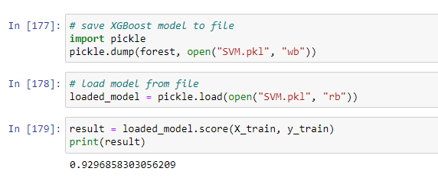
CONCLUSION
Working on this project is very knowledgeable and worth the effort. Through this project, one can know a lot about the phishing websites and how they are differentiated from legitimate ones.
We have also made a pickle file to create a website where users have to enter a URL and system based on our training will give the result whether it is a phishing or a legitimate website.

Slide 21
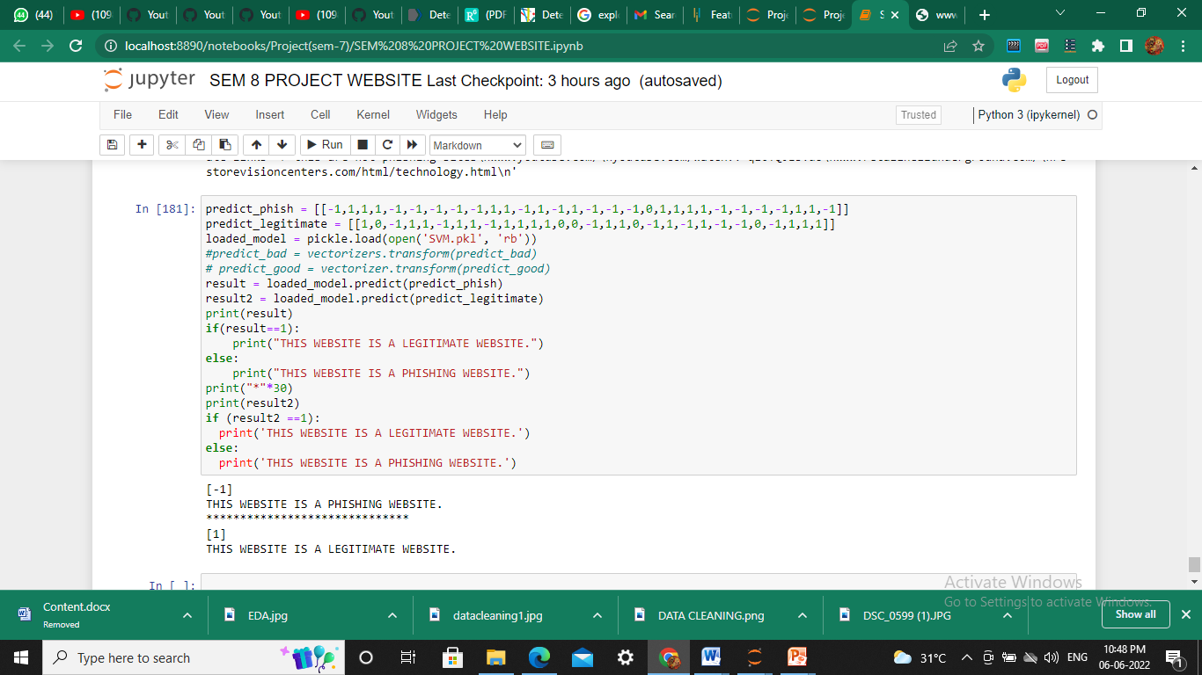
We have taken data from the data set and checked manually whether it is giving correct and appropriate result.

Slide 22
FUTURE SCOPE
We have created a website. However this project can be taken further by creating a browser extensions of developing a GUI.
More machine learning algorithms can be applied for better comparison and result.
We can apply deep learning techniques also to this project.

Slide 23
REFERENCE
Published by Vaibhav Patil, Pritesh Thakkar Prof. S. P. Godse, Tushar Bhat and Chirag Shah of “Detection and Prevention of Phishing Websites using Machine Learning Approach”, Dept. of Computer Engineering in Sinhgad Academy of Engineering Pune, India 2018.
Ankit Kumar Jain and B. B. Gupta, “Phishing Detection Analysis of Visual Similarity Based Approaches”, Hindawi 2017.
Jian Mao, Pei Li, Kun Li, Tao Wei, and Zhenkai Liang, “Bait Alarm Detecting Phishing Sites Using Similarity in Fundamental Visual Features”, INCS 2013.
Y. Zhang, J. I. Hong, and L. F. Cranor. Cantina: a content-based approach to
detecting phishing web sites. In WWW ’07: Proceedings of the 16th international
conference on World Wide Web, pages 639648, New York, NY, USA, 2007. ACM.
5. Haijun Zhang, Gang Liu, Tommy W. S. Chow, and Wenyin Liu, “Textual and Visual
Content-Based Anti-Phishing A Bayesian Approach”, IEEE 2011
Github link :- 1. https://github.com/atulpatelDS/Youtub...
2. https://www.kaggle.com/code/akashkr/phishing-url-eda-and-modelling/data

Slide 24

THANK
YOU

